Slide 1
Face recognition Attendance System Project
Name : Amartya menon

Slide 2
Abstract
Smart Attendance Management System is an application developed for daily student attendance in colleges or. schools. This project attempts to record attendance through face detection.
This System uses facial recognition technology to record the attendance through a high resolution digital camera/webcam that detects and recognizes faces and compare the recognize faces with students/known faces images stored in faces database(CSV).

Slide 3
Introduction
In general, the attendance system of the student can be maintained in two different forms namely, Manual Attendance System (MAS) Automated Attendance System (AAS). Manual Student Attendance Management system is a process where a teacher concerned with the particular subject need to call the students name and mark the attendance manually. Manual attendance may be considered as a time-consuming process or sometimes it happens for the teacher to miss someone or students may answer multiple times on the absence of their friends. So, the problem arises when we think about the traditional process of taking attendance in the classroom. To solve all these issues we go with Automatic Attendance System(AAS).

Slide 4
PROPOSED SYSTEM
The task of the proposed system is to capture the face of each student and to store it in the database for their attendance. The face of the student needs to be captured in such a manner that all the feature of the students' face needs to be detected, even the seating and the posture of the student need to be recognized. There is no need for the teacher to manually take attendance in the class because the system records a video and through further processing steps the face is being recognized and the attendance database is updated.

Slide 5
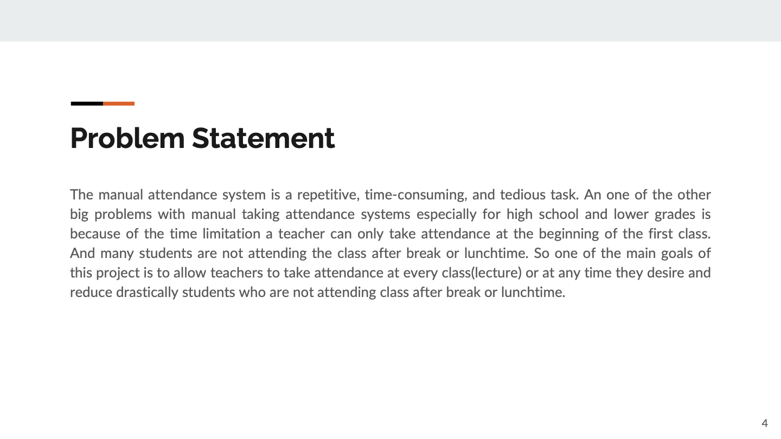

Slide 6
How facial recognition works
Facial recognition is the process of identifying or verifying the identity of a person using their face. It captures, analyzes, and compares patterns based on the person's facial details.
The face detection process is an essential step in detecting and locating human faces in images and videos.
The face capture process transforms analog information (a face) into a set of digital information (data or vectors) based on the person's facial features.
The face match process verifies if two faces belong to the same person.

Slide 7
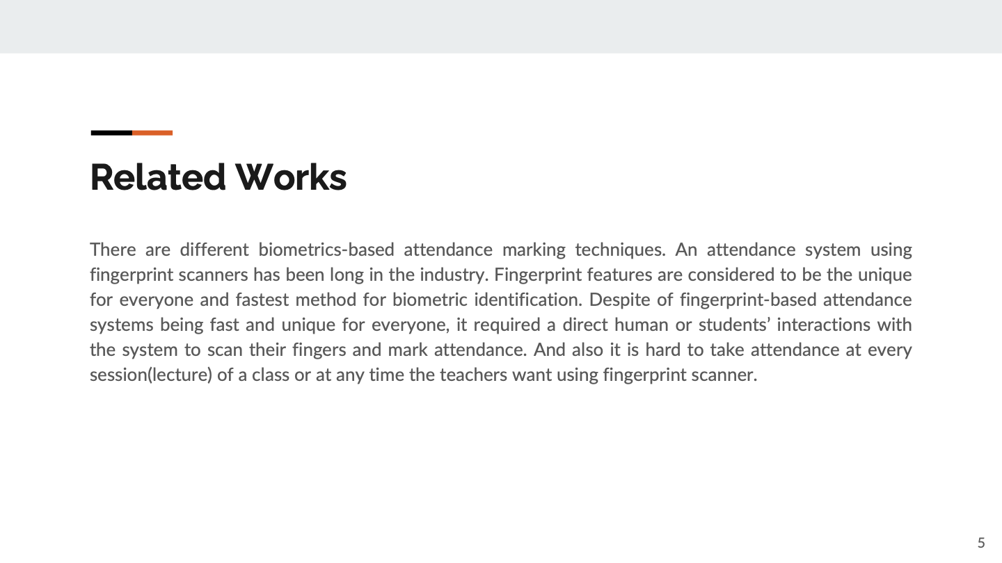

Slide 8
Procedure
The main rule of the project is that the video captured by the video is converted into an image for viewing and viewing. In addition, a known code image is also provided, otherwise the system will mark the site as non-existent.
Take a Video: The camera is positioned at a selected distance within the classroom to capture pre-video videos of perfect students of the class.
Divide as Frames in Video: The captured video must be converted to self-contained every second so that it can be easily accessed and seen by the students' faces in order to present the audience.
Face Recognition: Face detection is a process by which an image, provided as input (image) is searched to investigate any face, after finding the face processing image cleans the face image so that the face can easily be seen.
Facial Recognition: After completing the face detection and analysis, it is compared with the existing face on the student website to review the Individual presence.
After Processing: Post-processing process includes the process of updating expert names on an excel sheet. An excel sheet is usually kept weekly or monthly to record student attendance.

Slide 9
Conclusion
To conclude, An automated classroom attendance system can save time, increase the productivity of teachers, increase student’s punctuality, and also generate attendance reports and its analysis result easily. And Unlike fingerprinted based attendance system, a face recognition based attendance system doesn’t it required a direct human or students’ interactions with the system to mark attendance
Thus, the aim of this paper is to capture the video of the students, convert it into frames, relate it with the database to ensure their presence or absence, mark attendance to the particular student to maintain the record. The Automated Classroom Attendance System helps in increasing the accuracy and speed ultimately achieve the high-precision real-time attendance to meet the need for automatic classroom evaluation.

Slide 10
References
1. N.Sudhakar Reddy, M.V.Sumanth, S.Suresh Babu, "A Counterpart Approach to Attendance and Feedback System using Machine Learning Techniques",Journal of Emerging Technologies and Innovative Research (JETIR), Volume 5, Issue 12, Dec 2018.
2. Dan Wang, Rong Fu, Zuying Luo, "Classroom Attendance Auto-management Based on Deep Learning",Advances in Social Science, Education and Humanities Research, volume 123,ICESAME 2017.
3. Akshara Jadhav, Akshay Jadhav, Tushar Ladhe, Krishna Yeolekar, "Automated Attendance System Using Face Recognition", International Research Journal of Engineering and Technology (IRJET), Volume 4, Issue 1, Jan 2017.
4. B Prabhavathi, V Tanuja, V Madhu Viswanatham and M Rajashekhara Babu, "A smart technique for attendance system to recognize faces through parallelism", IOP Conf. Series: Materials Science and Engineering 263, 2017.
5. Prajakta Lad, Sonali More, Simran Parkhe, Priyanka Nikam, Dipalee Chaudhari, " Student Attendance System Using Iris Detection", IJARIIE-ISSN(O)-2395-4396, Vol-3 Issue-2 2017.

